Slide 1


Boosting Families in Virginia through Refundable Tax Credits
February 18, 2021
Ashley Kenneth and Chris Wodicka
The Commonwealth Institute for Fiscal Analysis

Slide 2
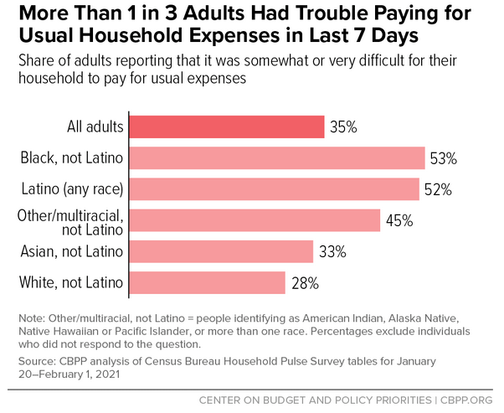
Families are hurting

Slide 3
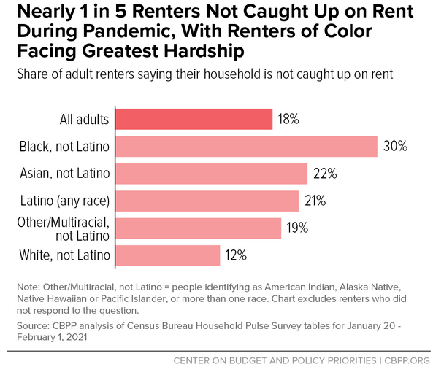
Families are hurting

Slide 4
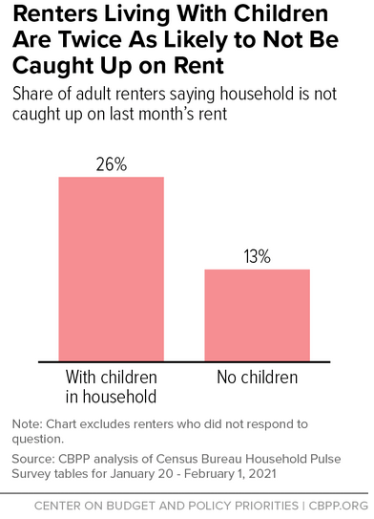
Families are hurting

Slide 5
Federal tax credits for families
Federal Earned Income Tax Credit (EITC)
Primarily helps working people with qualifying dependent children
Amount depends on income, filing status, # of children
Federal Child Tax Credit (CTC)
Up to $2,000 per child (16 and under)
Families with lower incomes and highest incomes don’t receive full $2,000

Slide 6
Federal tax credits for families
Official data for Virginia (2018)
About 600,000 families received federal EITC
About 435,000 families received federal CTC for families with low incomes
Third congressional district (2016)
84,000 families receive the federal EITC
57,000 families receive the federal CTC for families with low incomes
Notes:
Sources: https://www.cbpp-multimedia.org/1-25-19tax/1-25-19tax_eitc_virginia_3.pdf
https://www.cbpp-multimedia.org/1-25-19tax/1-25-19tax_actc_virginia_3.pdf

Slide 7
Improving Virginia’s EITC
Virginia has a state EITC that is up to 20% of a tax filer’s federal EITC
Not all families get the full value
Recent state proposals to address this issue:
Gov. Northam proposal in 2019
Del. Jay Jones proposal in 2020
Del. Ken Plum proposals in previous years

Slide 8
Biden Rescue Package
Includes many important provisions
Funding for public health response
Emergency relief funds for state/local govt.
Funds for K-12 and higher ed
Raise the Wage to $15/hr over time
Another round of “Economic Impact Payments”
Stimulus checks
Also includes federal EITC/CTC changes

Slide 9
Biden Rescue Package – EITC
Federal EITC
Temporarily boosts and expands federal EITC for working people without qualifying children
Would help about 419,000 people in Virginia
Avg. tax credit of $680
Notes:
Sources:
Avg. amounts: L673 EITC tab
ITEP estimates sheet ~Tax Budget/2021/Ways-Means-Relief-Plan-National-and-State.xlsx
# of families https://www.cbpp.org/research/federal-tax/house-ways-and-means-covid-relief-bill-includes-critical-expansions-of-child

Slide 10
Biden Rescue Package – CTC
Federal CTC
Increases to $3,000 per child (17 and under)
Increases to $3,600 per child (under 6)
Available to all families with low incomes
Avg. tax credit of $2,520
Possible advance distribution
Would help 1.6 million children in Virginia
Notes:
Sources:
Avg. amounts: L673 CTC tab
ITEP estimates sheet ~Tax Budget/2021/Ways-Means-Relief-Plan-National-and-State.xlsx
# of children https://www.cbpp.org/research/federal-tax/house-ways-and-means-covid-relief-bill-includes-critical-expansions-of-child

Slide 11
Questions? wodicka@thecommonwealthinstitute.org www.thecommonwealthinstitute.org
804-396-2051
Chris Wodicka, Senior Policy Analyst The Commonwealth Institute for Fiscal Analysis

